Slide 1

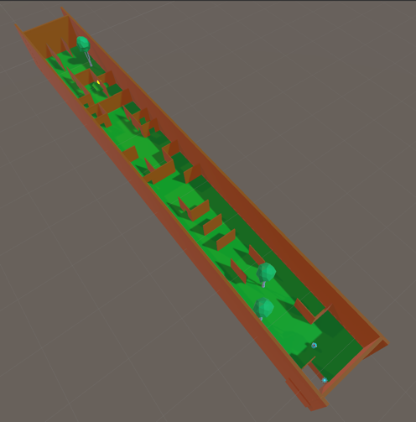
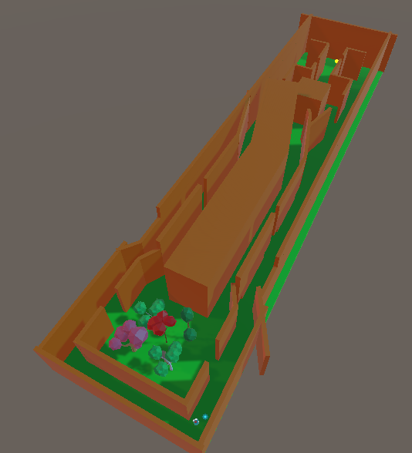
Movement-Based Gameplay and Procedural Generation
Harry Findlay
BSc (Hon) Computer Game Applications Development
Introduction
Method
Results
Discussion
Procedural Content Generation (PCG) is the process of algorithmically creating content using a set of pre-defined rules and processes created by a developer, and has been utilised since the 1980’s.
Procedural generation can be used to generate a multitude of features including, but not limited to level generation, player, enemy or creature generation, story and writing generation and even gameplay mechanics to an extent. The PCG can fine tined using a series or rules or guidelines.
PCG is less popular in 3D games when compared to 2D games, which is a reason as to why this research was conducted.
The chosen method of PLG was Wave Function Collapse.
The PLG utilized a series of nodes containing created map assets as templates to generate the environment.
A series of movement-based gameplay mechanics were created to test the research question.
Such mechanics include wall running, sliding, jumping and general movement.
Each tester was to test one man-made level and at least one generated level.
Each tester then had to fill out two surveys:
One survey on their general experience, the other, a more technical survey about their experience with the generation and mechanics.
Discussion of Results
The results gathered were mixed in some areas and strong in others. However, the results stated that, overall PCG and PLG is a welcome concept the movement-based games genre and that people would like to see more.
Additionally, people stated that, with polish and time, PLG is a tool that can and should be used for content and map generation in the industry of movement-based games in future.
Generally, it was stated that both the PLG and gameplay mechanics need additional work to be industry-ready. It was reported that some users experienced incompletable levels, and that the movement mechanics felt floaty – as if they were in a low gravity zone.
Some key results included:
All but one tester was a gaming hobbyist.
All testers showed varying levels of interest of seeing more PLG.
  All interest supported this in different levels.
Some testers experienced incompletable levels from the generation.
Some testers did not like the movement.
All but one tester replayed multiple generated levels.
The WFC was mostly successful at generating well-flowing and completable maps.
All planned features from the proposal were successfully implemented into the prototype created. Though, after user testing, it was found that some of the implementations required work, rework and/or general polish.
Generally, it was stated that both the PLG and gameplay mechanics need additional work to be industry-ready. It was reported that some users experienced incompletable levels where they were boxed in or in an endless loop of falling into a pit.
The gameplay mechanics contained the same feedback from testers that gave room for improvement points. It was stated that the movement felt “floaty” in a way that mimicked being in a low-gravity area. It was also stated that the controls for the more advanced gameplay mechanics would benefit from being simplified.
Overall, the project was successful in creating a model to gather data aimed at the research question, and the data gathered was valid, strong and of key importance.
Aim
This project aims to research the implementation of Procedural Level Generation (PLG) in movement-based video games and evaluate whether PLG is reliable and suitable enough to be used in future instalments into the movement-based video games genre.
PLG is relatively popular the 2D game space. However, only so much movement can be implemented into a 2D game, which sparked curiosity regarding how PLG would handle 3D space. Utilising gameplay mechanics with a strong emphasis on smooth and responsive movement-based mechanics, this research aims to test the capability of PLG for upcoming games of the genre. Additionally, to evaluate the use-case of PCG for these games in the near-future industry.
Conclusion
Overall, the research question was answered, showing that testers would welcome to addition of PLG to the 3D environment creation within movement-based games and that, generally, the relationship between PGL and movement-based gameplay mechanics is strong when executed correctly.
Final Display of a generated level
References
Angel, J.(2014). Game Maps: Parkour Vision and Urban Rel ations. In: Schiller, G., Rubidge, S. (eds) Choreographic Dwellings. New World Choreographies . Palgrave Macmillan, London. https://doi.org/10.1057/9781 137385673_11
Büyükşar, O., Yıldız, D. and Demirci, S. (2024) Enhancing
wave function collapse algorithm for procedural map
generation problem, Niğde Ömer Halisdemir Üniversitesi
Mühendislik Bilimleri Dergisi. Available at: https://dergipark.org.tr/en/pub/ngumuh/issue/86158/1361413 (Accessed: 13 October 2024).
Final Display of the man-made level

